Slide 1


HTML Forms

Slide 2

Topics
Introduction to HTML form
HTML form attributes
HTML form elements
HTML form submission

Slide 3
Introduction to HTML form
HTML form is like a virtual questionnaire on websites.
Users interact by inputting information and submitting.
Input fields are where users type name, phone, email, password.
Clicking "Sign Up" sends data to the server for processing.
Server uses input to create a new account on the website.

Slide 4
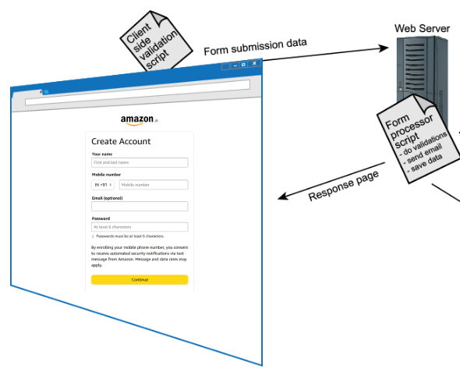

Slide 5
Form attributes
“action” Attribute
“method” Attribute
“target” Attribute
_self
_blank
_top
“autocomplete” Attribute
“enctype” Attribute
application/x-www-form-urlencoded
multipart/form-data
text/plain

Slide 6
Form elements
Input fields
Labels
Text area
Radio Buttons
Select Lists

Slide 7
Form Submission
<input type="submit"> is a common way to make a form's submit button. When clicked, it sends form data to the URL in the <form> action with the specified HTTP method.

Slide 8

THANK YOU

